Slide 1

Python vs. C++

Slide 2
File I/O
File Input and Output in C++ is similar to Input and Output to the Console, in that both are handled with streams.
// Console Output
cout << "Hello" << endl;
// Input from Console
cin >> username;
// File Output
outputFile << "Hello" << endl;
// Input from File
inputFile >> username;

Slide 3
File I/O
When you're reading from or writing to a file, you must:
  #include <fstream> library
  Create a ifstream object (for input), or an ofstream object (for output)
  Open a text file
  Write or read the data
  Close the text file when done

Slide 4
Writing to a file
#include <fstream>
using namespace std;
int main()
{
ofstream outFile;
outFile.open( "simple-out.txt" );
outFile << "This is a simple file" << endl;
outFile << "This has the same functionality as" << endl;
outFile << "if you were using cout" << endl;
outFile.close();
return 0;
}

Slide 5
Reading from a file
#include <fstream>
using namespace std;
int main()
{
ifstream inFile;
inFile.open( "data.txt" );
string name;
int age;
float balance;
infile >> name >> age >> balance;
inFile.close();
return 0;
}

Slide 6
Reading from a file
Like with cin, C++ uses whitespace as a delimiter. When reading from a file, it will automatically read one word (or number, ie 2, 24, 100) at a time.

Slide 7
Reading an entire file
You can use a while loop to continue reading a file until the end.
If the conditional statement
( inFile >> ages[index] )
returns false, that means there are no words left in the file.
int ages[100];
int index = 0;
while ( inFile >> ages[ index ] )
{
index++;
}

Slide 8
More than just .txt
Many files are just text files that follow a specific style. When you output to a file, you can create more than just a plaintext (.txt) file. You can create...
  A source-code file: .cpp, .py
  An HTML file: .html
  A CSV file: .csv (a basic spreadsheet format)
  An XML file: .xml
  And more!

Slide 9
File I/O
Additional Reading
  Chapter 2.4 of the Pearson textbook
  Python vs. C++ class resource
  https://github.com/Moosader/Python-vs-CPP
  http://www.cplusplus.com/doc/tutorial/files/
  http://www.learncpp.com/cpp-tutorial/136-basic-file-io/

Slide 10
Random Numbers
Random Numbers are another handy thing to know early on. In Python, we generate random numbers with:
import random
# Generate a random number between 1 and 10
randNumber = random.randint( 1, 10 )
print( randNumber )

Slide 11
Random Numbers
In C++, we will need to #include the stdlib.h library.
#include <stdlib.h>
#include <iostream>
using namespace std;
int main()
{
// Generate a random number
// between 0 and 9
int randNum = rand() % 10;
cout << randNum << endl;
return 0;
}

Slide 12
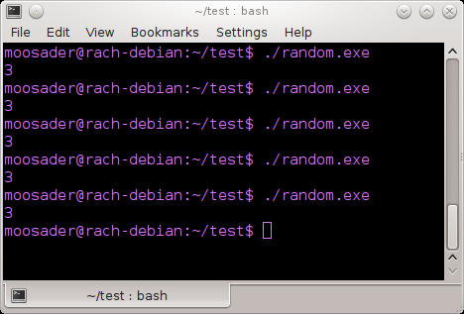
Random Numbers
However, if you run this program multiple times you will see that you keep getting the same number over and over!

Slide 13
Random Numbers
Random Numbers generated by a computer aren't truly random.
To make our numbers appear more random, we need to seed the random number generator.
Often, the current time is used as the random seed, which ensures that each time the program is run it has a new seed.

Slide 14
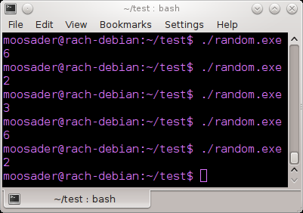
Random Numbers
#include <stdlib.h> // for random
#include <time.h> // for time
#include <iostream>
using namespace std;
int main()
{
// Seed the random number generator
srand( time( NULL ) );
// Generate # between 0 and 9
int randNum = rand() % 10;
cout << randNum << endl;
return 0;
}

